Slide 1
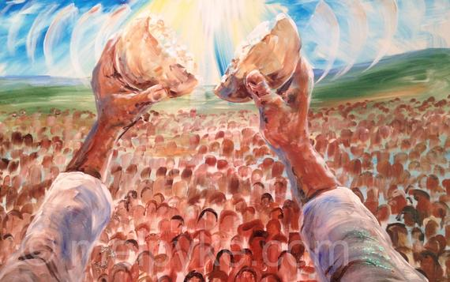
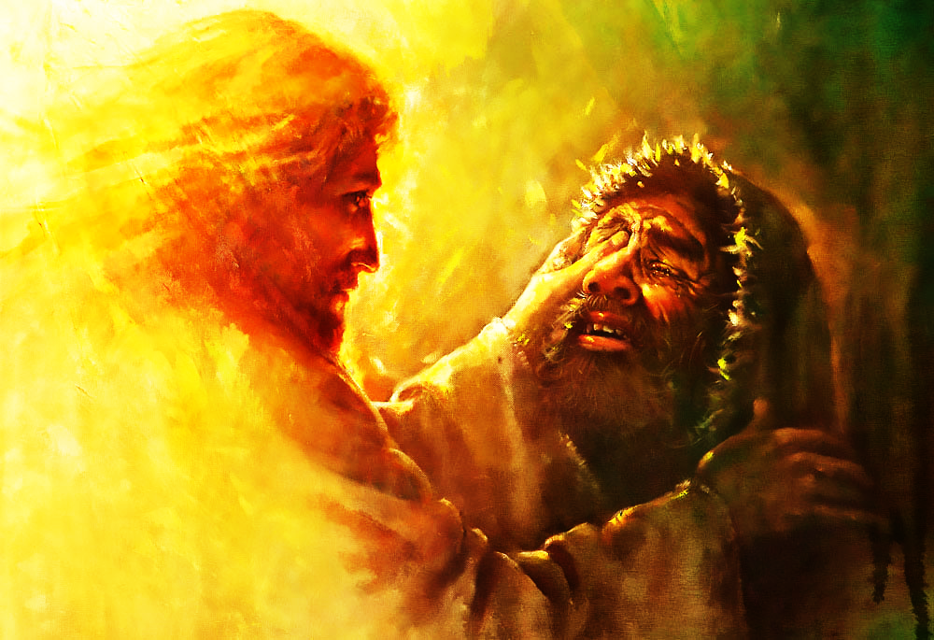
Compassionately Responding to People Suffering with Life Issues

Slide 2
Overview
Life Issues
Suffering
Worldview of Suffering
Jesus’ Suffering
Scriptural view of Suffering
Compassion
Jesus Moved by Compassion
Compassionate Response to Suffering

Slide 3
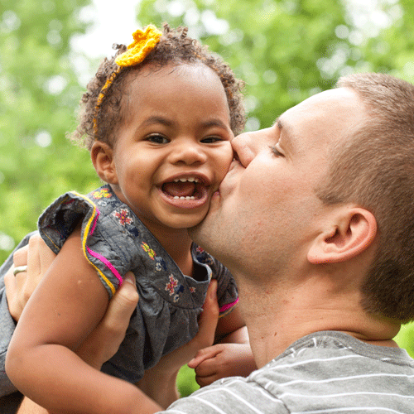
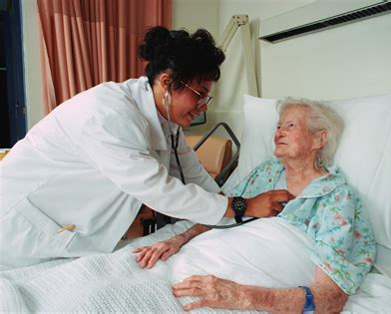
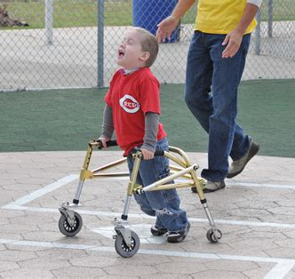
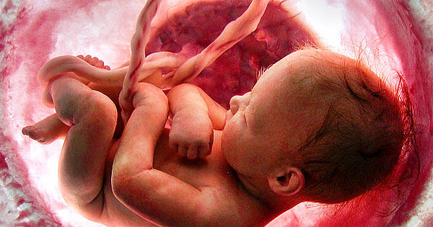
Life Issues
Marriage
Fertility
Birth
Adoption
Disability
End-of-Life

Slide 4
Suffering
Suffering in body, mind, and spirit
When?
Since the Fall into sin
According to God’s will (Job 1:9-11)
Why do Christians suffer?
Worldview of suffering
Scriptural view of Christian suffering

Slide 5
Worldview of Suffering
Misperception of suffering
Based on what you do and how you feel
Think, choose, act
Results
Immediate avoidance = greater long-term suffering
Self-sacrifice = taking on unnecessary burden
Hinder God’s plan for suffering
Suffering becomes purposeless
Helpless and hopeless – Satan’s goal

Slide 6
Jesus’ Suffering
Physical suffering
By His wounds/stripes we are healed (Isaiah 53:5)
Crucifixion (Matthew 26; Mark 15, Luke 23)
Mental and emotional suffering
Mocking (Psalm 22:6-8)
Despising shame (Hebrews 12:2)
Abandoned by friends (Mark 14:50-72)
Spiritual suffering
Stricken, smitten, and afflicted (Isaiah 53:4)
Abandoned by God (Matthew 27:46; Mark 15:34)

Slide 7
Christian Suffering
We are intended to suffer
To be conformed to image of Christ (Romans 8:29)
Suffering given as a gift (Philippians 1:29-30)
It is the Lord’s will
Pick up your cross and follow me (Luke 9:23; Mark 8:34)
Take my yoke and learn from me (Matthew 11:29)
Suffer because our Lord suffered (1 Corinthians 15:49)
God, hidden in the opposites, is nearer to us
Jesus’ death brings mankind life (John 12:24-26)
He is with us in trouble and will deliver us (Psalm 91:15)
Hidden for a moment and then gathers us with great mercies (Isaiah 54:7-10)

Slide 8
Christian Suffering
God’s love is revealed
Ultimate love in the death of His Son (John 3:16-17)
Discipline for those He loves (Hebrews 12:6-8; Revelations 3:19)
All works together for the good (Romans 8:28)
Orients us to the Word and cross of Jesus
Leads us to prayer (Isaiah 26:16)
Ongoing for eternal life (Hebrews 13:12-14)
Makes us dependent on God (2 Corinthians 12:7-10)

Slide 9
Christian Suffering
For our Christian development
Prepare us for the greater glory (2 Corinthians 4:17-18)
Yields peaceful fruit of righteousness (Hebrews 12:11)
Reveals sin (1 Corinthians 11:30-32; Jerimiah 30:11)
Testing our faith (James 1:2-12)
We are encouraged in the battle against Satan
Confident Satan cannot harm us eternally (Matthew 10:28-30)
God is for me, who can be against me (Romans 8:31-32)

Slide 10
How Christians Suffer
In many ways (2 Corinthians 4:8-9)
Suffering is normal (1 Peter 4:12)
Suffering is never too severe
You will not be overtaken (1 Corinthians 10:13)
Hope removes shame and guilt (Romans 5:5)
Prayer delivers relief (Psalm 50:15)
Faith in God’s purpose and His love, not the circumstances (Job 13:15)
Rejoice in suffering
Joy and blessing in suffering (1 Peter 4:13-14)
Spiritual contentment (Philippians 4:11-13)
Martyred for His namesake (Acts 5:41)

Slide 11
Compassion
Greek – splagchnizomai (splangkh-nid’-zom-ahee)
To be moved by the inward parts
Movement by compulsion
Not an act by human nature (Romans 3:9-18)
Lord acting through us

Slide 12
Jesus Moved by Compassion
Harassed and helpless without a shepherd (Matthew 9:36)
Healing
Diseases and afflictions (Matthew 14:14; Mark 6:34);
Blind men (Matthew 20:34)
Cleansed the leper (Mark 1:41)
Feeds the masses (Matthew 15:32; Mark 8:2)
Casts out demons
Boy with seizures (Mark 9:22)
Restores life
Widow’s son (Luke 7:13)

Slide 13
Compassionate Response to Suffering
Do not explain suffering (Job 11:7-8)
Act as ambassadors of Christ (2 Corinthians 5:20-21)
Speak about suffering in Truth and Love (2 Timothy 4:2)
Strengthen dependence on Christ
Bear one another’s burdens (Galatians 6:1-2)
Daily repentance and renewal through forgiveness of sins (James 5:14-16)
Prayer (1 Thessalonians 5:11)
Be prepared to share the reason for your Hope (1 Peter 3:14-16)

Slide 14
Questions
Deaconess Chrissie Gillet, Psy.D.
Word of Hope Director
Lutherans For Life
cgillet@lutheransforlife.org

